Slide 1
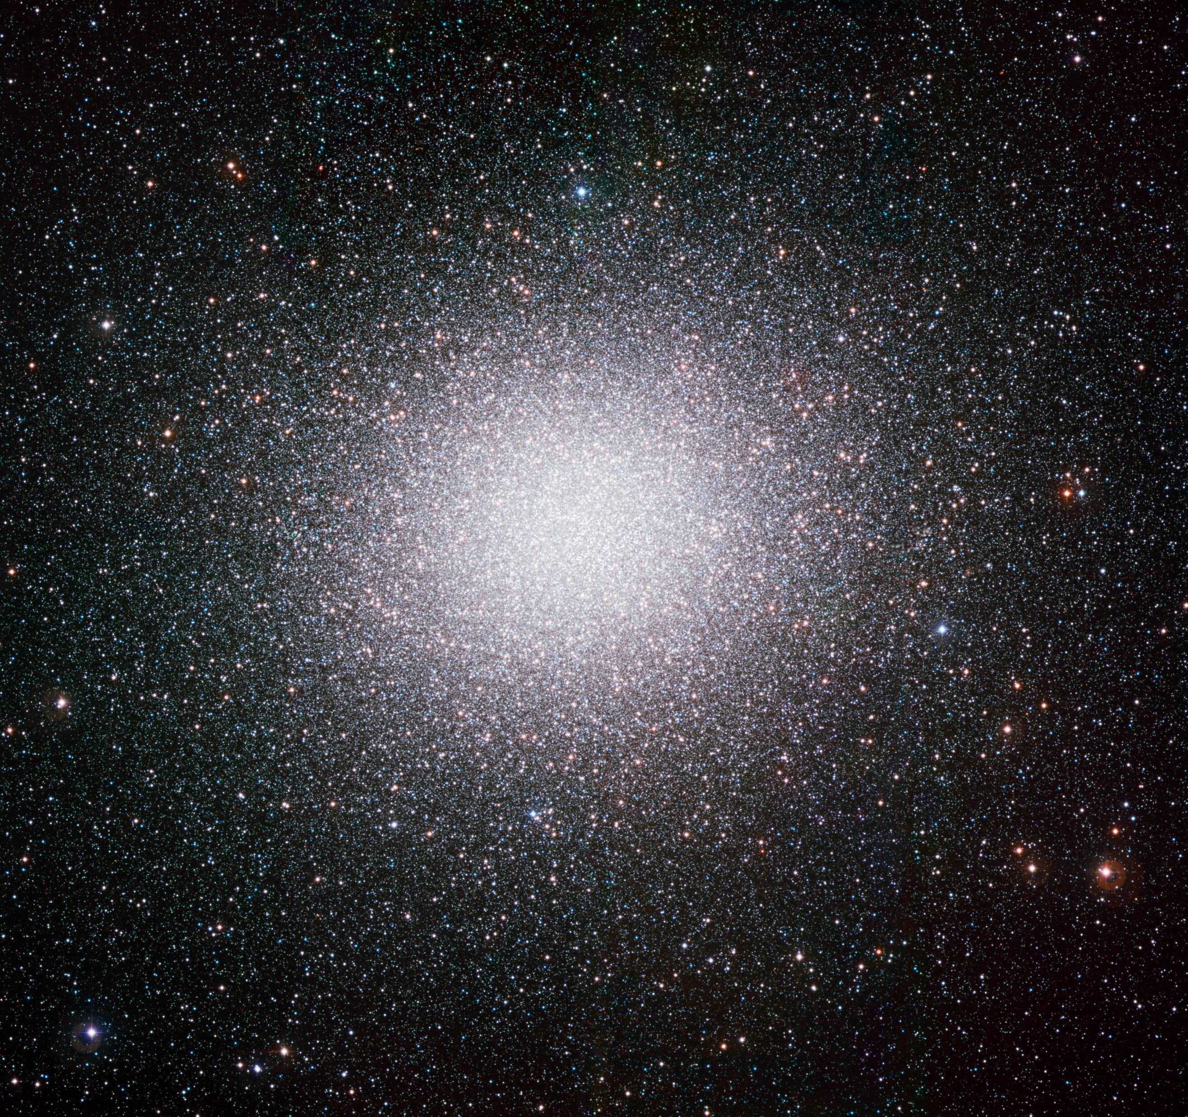
Stellar Cluster Evolution
Studying the evolution of globular clusters by applying N-body simulation techniques
Omega Centauri (NGC5139) taken at the ESO’s La Silla Observatory
Image credit: ESO (CC4.0 license)
https://www.eso.org/public/images/eso0844a/

Slide 2
Overview
Gravity
Code
Clusters
Notes:
Gravity is interesting
How I simulate it
Clusters are perfect

Slide 3
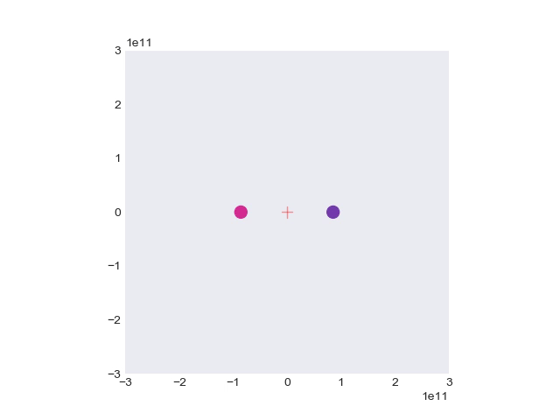
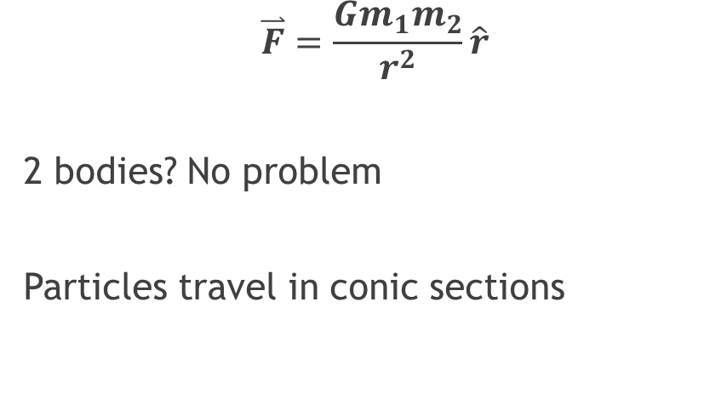
The Basics
$$\overset{⃑}{F}=\frac{Gm_{1}m_{2}}{r^{2}}\hat{r}$$
2 bodies? No problem
Particles travel in conic sections
Notes:
Gravity is interesting
2 bodies = solved problem, travel in ellipses

Slide 4
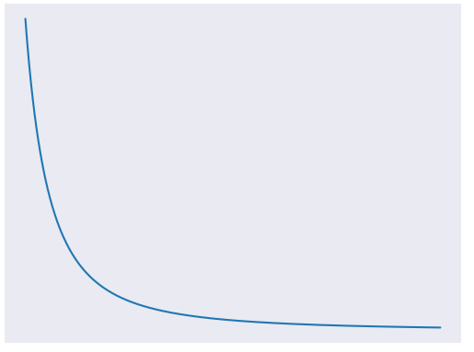
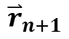
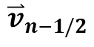
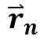
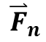
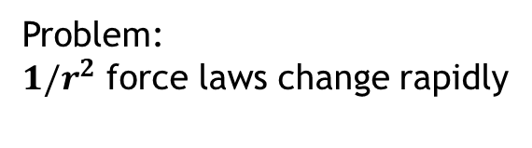
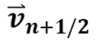
More bodies, More problems
Problem:
$1/r^{2}$ force laws change rapidly
The general case for 3 or more bodies is not analytically solvable
Numerical methods are required…
Solution: Leapfrog
$${\overset{⃑}{v}}_{n−1/2}$$
$${\overset{⃑}{F}}_{n}$$
$${\overset{⃑}{v}}_{n+1/2}$$
$${\overset{⃑}{r}}_{n}$$
$${\overset{⃑}{r}}_{n+1}$$
Notes:
3+ is unsolved
numerical methods: find force, move particle, repeat
Issue: force law changes rapidly, under or overestimate
Leapfrog solution where v is calculated either side of F

Slide 5
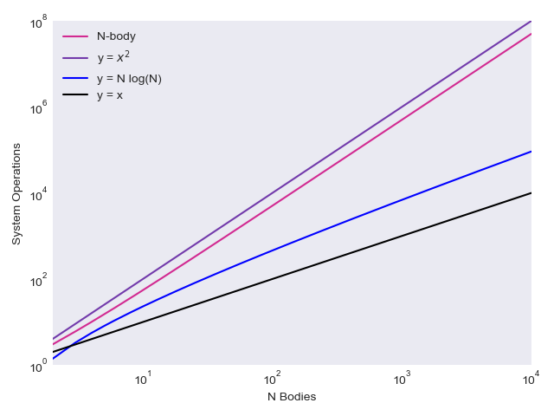
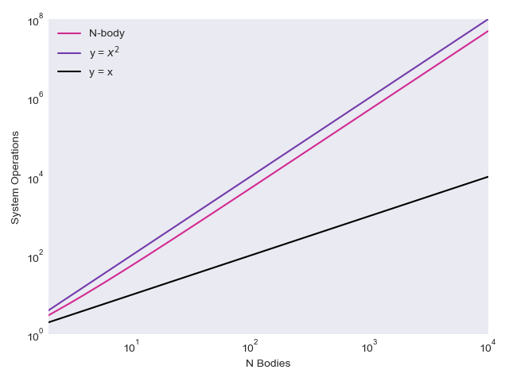
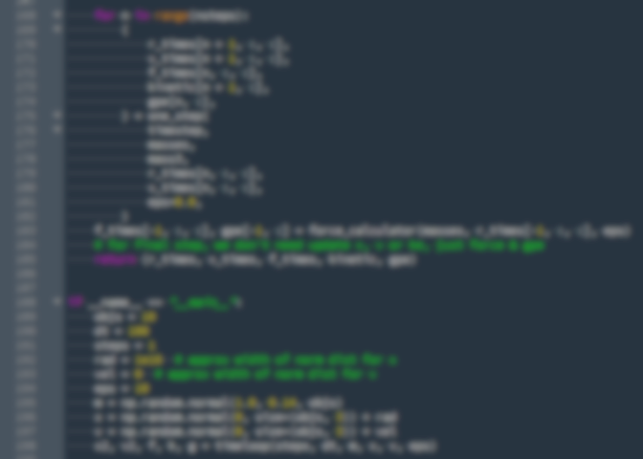
Python and Complexity
Every pair of particles must be calculated
Brute force complexity: O(N²)
Barnes-Hut: O(N log N)^{[1]}
[1]: Barnes, J., Hut, P. A hierarchical O(N log N) force-calculation algorithm. Nature 324, 446–449 (1986) doi:10.1038/324446a0
Notes:
I wrote N Body code in Python
Every pair of particles has to be calculated, which is slow
Big O of N squared
Considering implementing Barnes Hut N log N

Slide 6
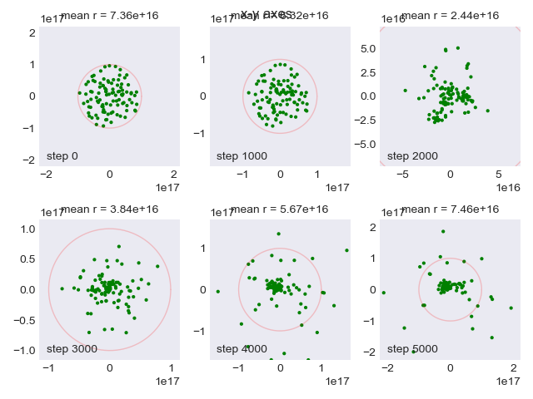
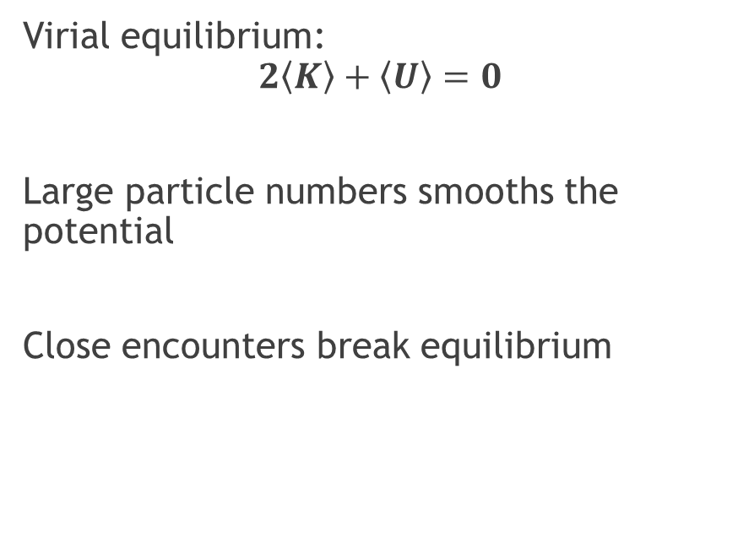
Clusters
Virial equilibrium:
$$2\left\langle K\right\rangle +\left\langle U\right\rangle =0$$
Large particle numbers smooths the potential
Close encounters break equilibrium
Notes:
Focusing on globular clusters, have thousand members
Virial equilibrium means balanced gravitational and kinetic
~Million particles is smooth potential (collisionless, mesh)
Smaller systems break equilibrium (close encounters)
System shows collapse then loss

Slide 7
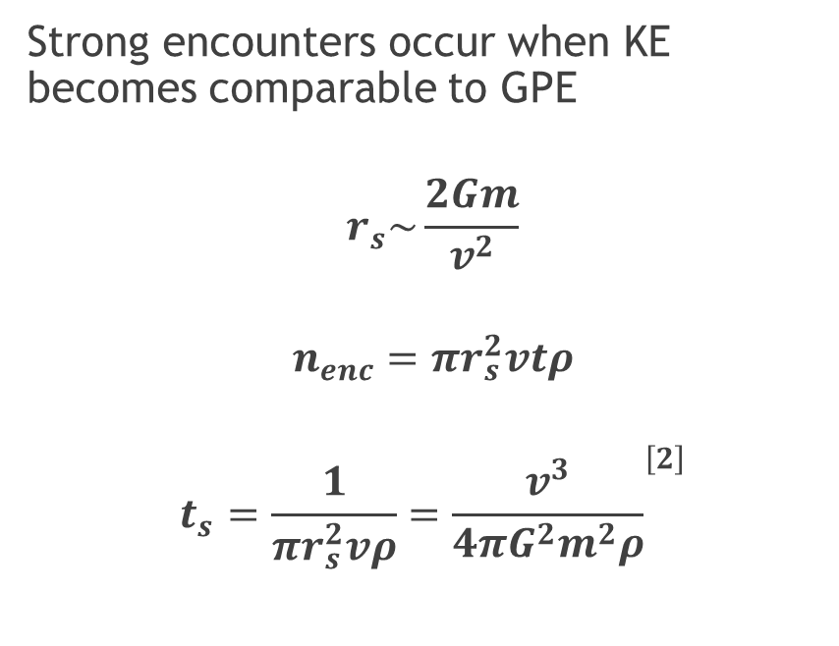
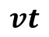
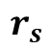
Encounters
Strong encounter zone
Strong encounters occur when KE becomes comparable to GPE
$$r_{s}\sim \frac{2Gm}{v^{2}}$$
$$n_{enc}=πr_{s}^{2}vtρ$$
$$t_{s}=\frac{1}{πr_{s}^{2}vρ}={\frac{v^{3}}{4πG^{2}m^{2}ρ}}^{\left[2\right]}$$
$$r_{s}$$
$$vt$$
[2]: Kutner, M. L. (2003) Astronomy: A Physical Perspective. 2nd edn. Cambridge: Cambridge University Press. doi: 10.1017/CBO9780511802195.
Notes:
Why did the last thing explode?
Strong encounters when gravitational and kinetic become comparable
Number of strong encounters per unit time

Slide 8
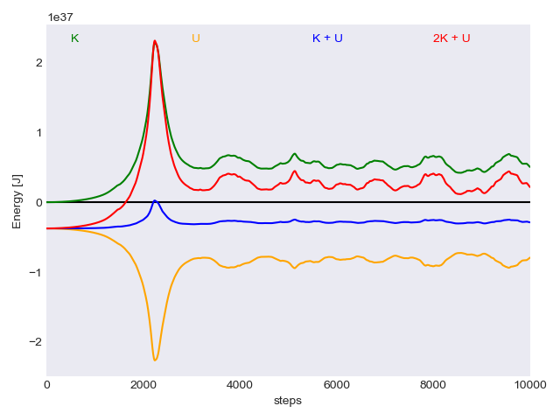
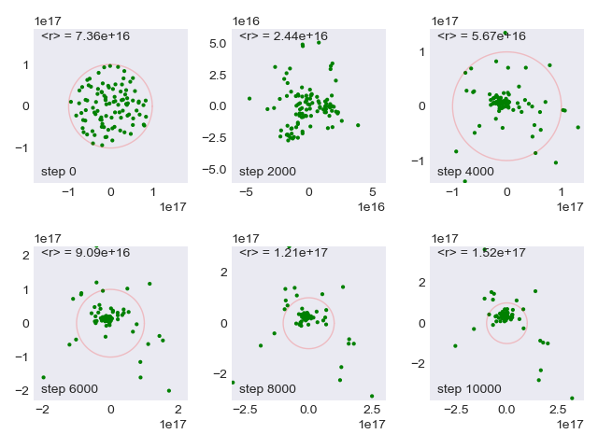
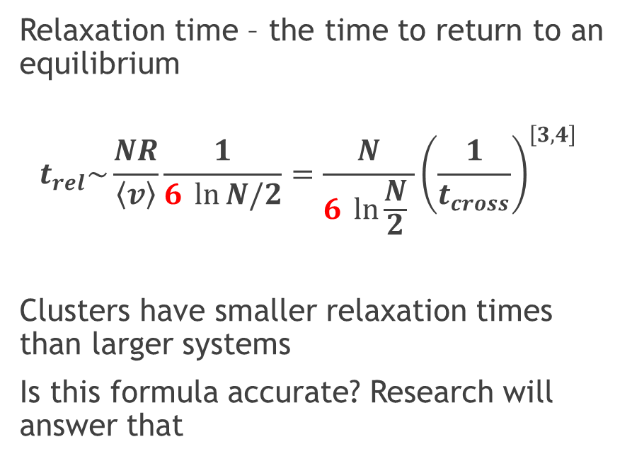
Crossing and Relaxation
Relaxation time – the time to return to an equilibrium
$$t_{rel}\sim \frac{NR}{\left\langle v\right\rangle }\frac{1}{6 \ln{N/2}}=\frac{N}{6 \ln{\frac{N}{2}} }{\left(\frac{1}{t_{cross}}\right)}^{\left[3,4\right]}$$
Clusters have smaller relaxation times than larger systems
Is this formula accurate? Research will answer that
[3]: http://www.astro.rug.nl/~vdkruit/jea3/homepage/dynamics02.pdf
[4]: http://www.astro.caltech.edu/~george/ay20/Ay20-Lec15x.pdf
Notes:
Disturbed system return to equilibrium (e.g. puddle)
Strong encounters important but weak mostly dominate
(mention range of values)
Large N means weak dominate but small N are affected
Accuracy of assumptions, testing required

Slide 9
Any Questions?
Thanks for listening
So, we know that gravity is interesting but unsolvable
The code simulates well, but it’s slow
Close encounters dominate for small particle numbers, but what is the relationship to N?
Notes:
Interesting
Works but slow
Small encounter crossing and relaxation times
QUESTIONS?

Slide 10
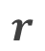
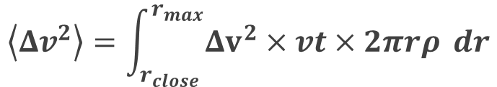
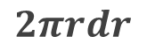
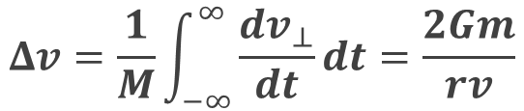
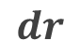

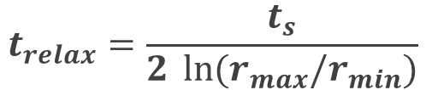
Close Encounter Derivation
$$dr$$
$$Δv=\frac{1}{M}\int_{−∞}^{∞}{\frac{dv_{⊥}}{dt}dt=\frac{2Gm}{rv}}$$
$$r$$
$$\left\langle Δv^{2}\right\rangle =\int_{r_{close}}^{r_{max}}{Δv^{2}×vt×2πrρ} dr$$
$$t_{relax}=\frac{t_{s}}{2 \ln{{(r}_{max}/r_{min})}}$$
$$2πrdr$$
Substitute $t_{s}$ and divide by $t_{cross}$

